Slide 1
Divide and Conquer

Slide 2
Introduction
Divide and Conquer algorithms consist of two parts:
Divide: Smaller problems are solved recursively (except, of course, the base cases).
Conquer: The solution to the original problem is then formed from the solutions to the subproblems.
Examples
Binary Search
Quick Sort
Merge Sort
Long Integer Multiplication
Maximum Sum Subarray
Strassen’s Algorithm for Matrix Multiplication etc.

Slide 3
Integer Multiplication
1011
x1111
1011
10110
101100
+1011000
10100101
The standard integer multiplication routine of 2 n-digit numbers
Involves n multiplications of an n-digit number by a single digit
Plus the addition of n numbers, which have at most 2 n digits
quantity time
Multiplication n-digit by 1-digit n O(n)
Additions 2n-digit by n-digit max n O(n)
Total time = n*O(n) + n*O(n) = 2n*O(n) = O(n²)

Slide 4
Integer Multiplication
1011
x1111
1011
10110
101100
+1011000
10100101
Let’s consider a Divide and Conquer Solution
Imagine multiplying an n-bit number by another n-bit number.
We can split up each of these numbers into 2 halves.
Let the 1st number be I, and the 2nd number J
Let the “left half” of the 1st number by I_{h} and the “right half” be I_{l}.
So in this example: I is 1011 and J is 1111
I becomes 10*2² + 11 where I_{h} = 10*2² and I_{l} = 11.
and J_{h} = 11*2² and J_{l} = 11

Slide 5
Integer Multiplication
So for multiplying any n-bit integers I and J
We can split up I into (I_{h} * 2^{n/2}) + I_{l}
And J into (J_{h} * 2^{n/2}) + J_{l}
Then we get
I x J = [(I_{h} x 2^{n/2}) + I_{l}] x [(J_{h} x 2^{n/2}) + J_{l}]
I x J = I_{h} x J_{h} x 2^{n} + (I_{l} x J_{h} + I_{h} x J_{l}) x 2^{n/2} + I_{l} x J_{l}
So what have we done?
We’ve broken down the problem of multiplying 2 n-bit numbers into
4 multiplications of n/2-bit numbers plus 3 additions.
T(n) = 4T(n/2) + θ(n)
Solving this using the master theorem gives us…
T(n) = θ(n²)

Slide 6
Integer Multiplication (Karatsuba Algorithm)
So we haven’t really improved that much,
Since we went from a O(n²) solution to a O(n²) solution
Can we optimize this in any way?
We can re-work this formula using some clever choices…
Some clever choices of:
P₁ = (I_{h} + I_{l}) x (J_{h} + J_{l}) = I_{h}xJ_{h} + I_{h}x J_{l} + I_{l}xJ_{h} + I_{l}xJ_{l}
P₂ = I_{h} x J_{h} , and
P₃ = I_{l} x J_{l}
Now, note that
P₁ - P₂ – P₃ = I_{h}xJ_{h} + I_{h}xJ_{l} + I_{l}xJ_{h} + I_{l}xJ_{l} - I_{h}xJ_{h} - I_{l}xJ_{l}
= I_{h}xJ_{l} + I_{l}xJ_{h}
Then we can substitute these in our original equation:
I x J = P₂ x 2^{n} + [P₁ - P₂ – P₃]x 2^{n/2} + P₃.

Slide 7

Integer Multiplication
I x J = P₂ x 2^{n} + [P₁ - P₂ – P₃]x 2^{n/2} + P₃.
Have we reduced the work?
Calculating P2 and P3 – take n/2-bit multiplications.
P1 takes two n/2-bit additions and then one n/2-bit multiplication.
Then, 2 subtractions and another 2 additions, which take O(n) time.
This gives us : T(n) = 3T(n/2) + θ(n)
Solving gives us T(n) = θ(n^{(log}2³⁾), which is approximately T(n) = θ(n^{1.585}), a solid improvement.

Slide 8
Integer Multiplication
Although this seems it would be slower initially because of some extra pre-computing before doing the multiplications, for very large integers, this will save time.
Q: Why won't this save time for small multiplications?
A: The hidden constant in the θ(n) in the second recurrence is much larger. It consists of 6 additions/subtractions whereas the θ(n) in the first recurrence consists of 3 additions/subtractions.

Slide 9
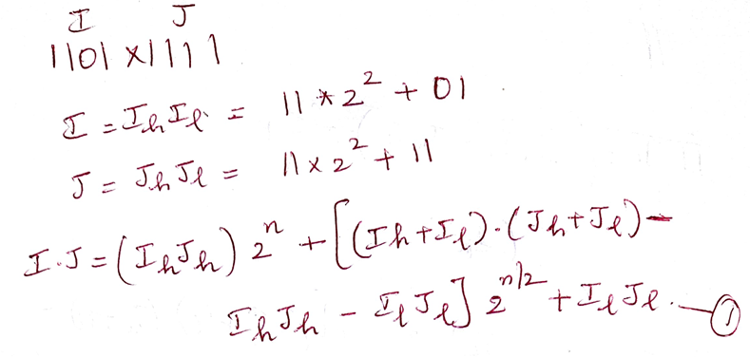
Integer Multiplication - Example

Slide 10
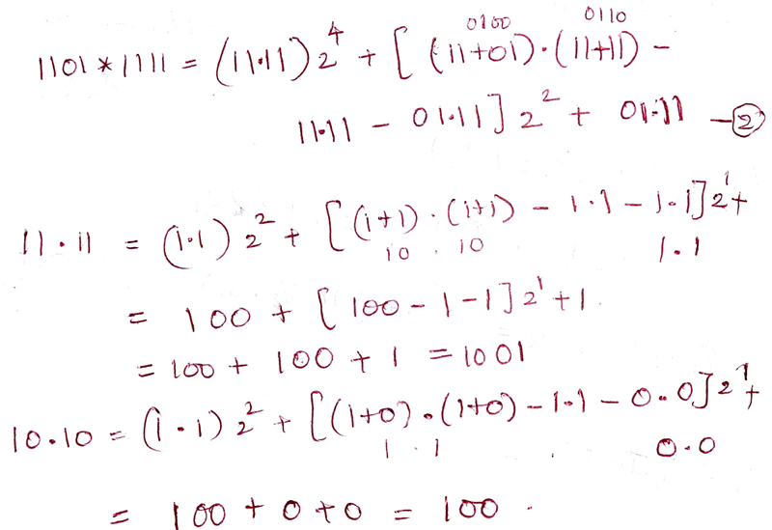
Integer Multiplication - Example

Slide 11
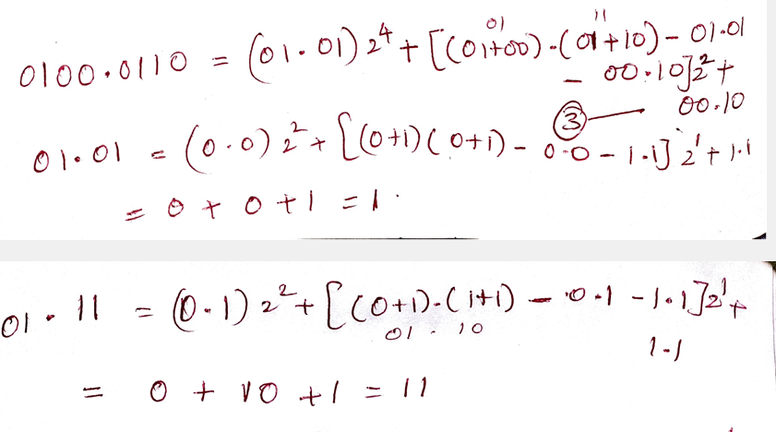
Integer Multiplication - Example

Slide 12
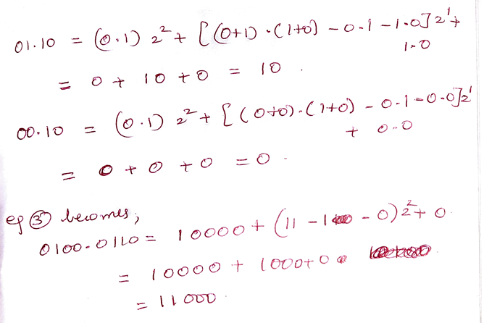
Integer Multiplication - Example

Slide 13
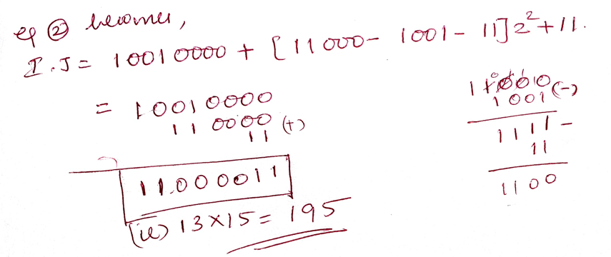
Integer Multiplication - Example

Slide 14
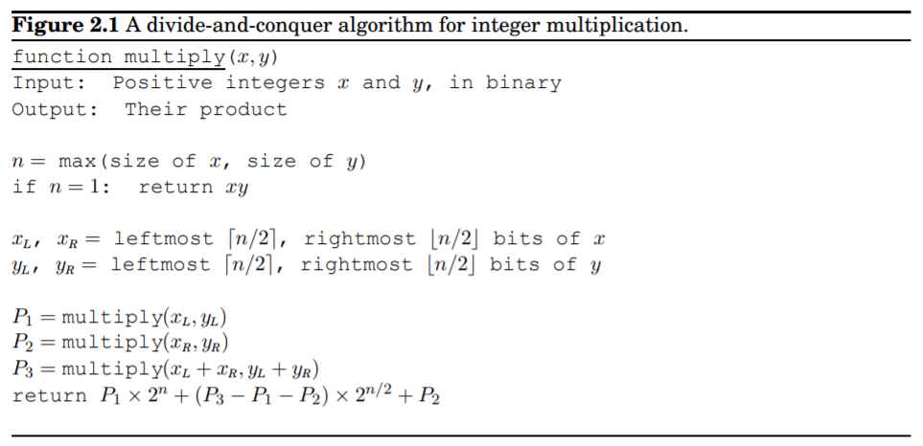
Pseudocode

Slide 15
Long Integer Multiplication
Solve
1101 x 1011
1234 x 2345

Slide 16
Maximum Sum Subarray
The maximum subarray problem is the task of finding the largest possible sum of a contiguous subarray, within a given one-dimensional array A[1…n] of numbers.
The time complexity of the Naive method is O(n^2).
Using Divide and Conquer approach, we can find the maximum subarray sum in O(nLogn) time.

Slide 17
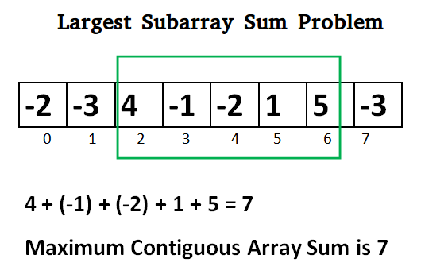
Maximum Sum Subarray

Slide 18
Solution #1 - Brute Force
The naive approach is to generate all the possible subarray and print that subarray which has maximum sum.
int MSS (int a[], int n)
{ int max=0
for(i=0 to n-1 do)
for(j=i to n-1 do)
int s=0
for (k=i to j do)
s=s+a[k]
if(s>max)
max= s
return max }
O(n³)
int MSS (int a[], int n)
{
int max=0
for(i=0 to n-1 do)
int s=0
for (k=i to n do)
s=s+a[k]
if(s>max)
max= s
return max
}
O(n²)

Slide 19
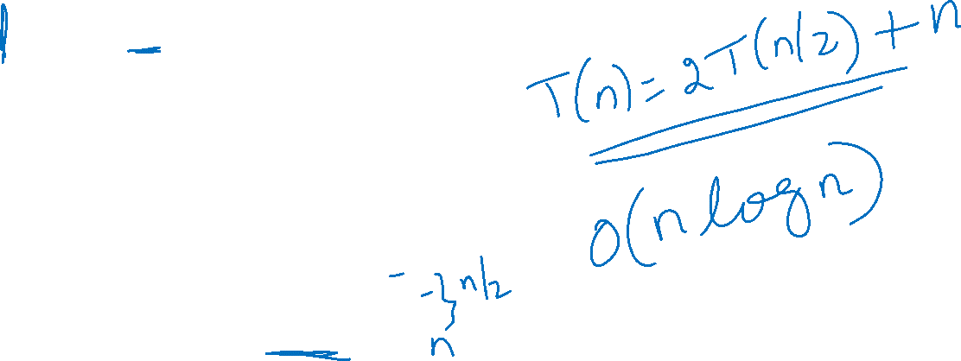
Solution #2 – Divide and Conquer
/ Returns sum of maxium sum subarray in aa[l..h]
int maxSubArraySum(int arr[], int l, int h)
{
// Base Case: Only one element
if (l == h)
return arr[l];
// Find middle point
int m = (l + h) / 2;
/* Return maximum of following three possible cases
a) Maximum subarray sum in left half
b) Maximum subarray sum in right half
c) Maximum subarray sum such that the subarray
crosses the midpoint */
return max(maxSubArraySum(arr, l, m),
maxSubArraySum(arr, m + 1, h),
maxCrossingSum(arr, l, m, h));
}

Slide 20
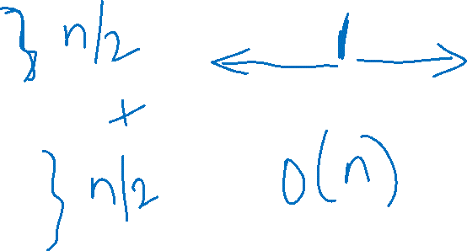
Maximum Sum Subarray
// Find the maximum possible sum in arr[] auch that arr[m] is part of it
int maxCrossingSum(int arr[], int l, int m, int h)
{
// Include elements on left of mid.
int sum = 0;
int left_sum = INT_MIN;
for (int i = m; i >= l; i--) {
sum = sum + arr[i];
if (sum > left_sum)
left_sum = sum;
}
// Include elements on right of mid
sum = 0;
int right_sum = INT_MIN;
for (int i = m + 1; i <= h; i++) {
sum = sum + arr[i];
if (sum > right_sum)
right_sum = sum;
}
// Return sum of elements on left and right of mid returning only left_sum +
//right_sum will fail for [-2, 1]
return max(left_sum + right_sum, left_sum, right_sum);
}

Slide 21
Maximum Sum Subarray - Example
2, -4, 1, 9, -6, 7, -3 Soln: 11

Slide 22
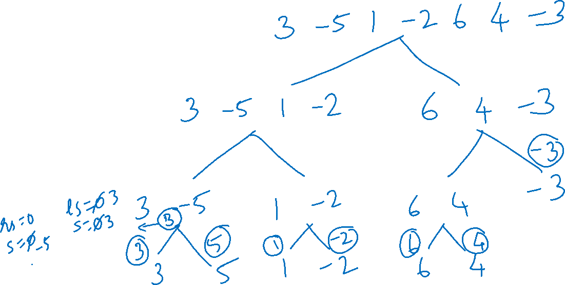
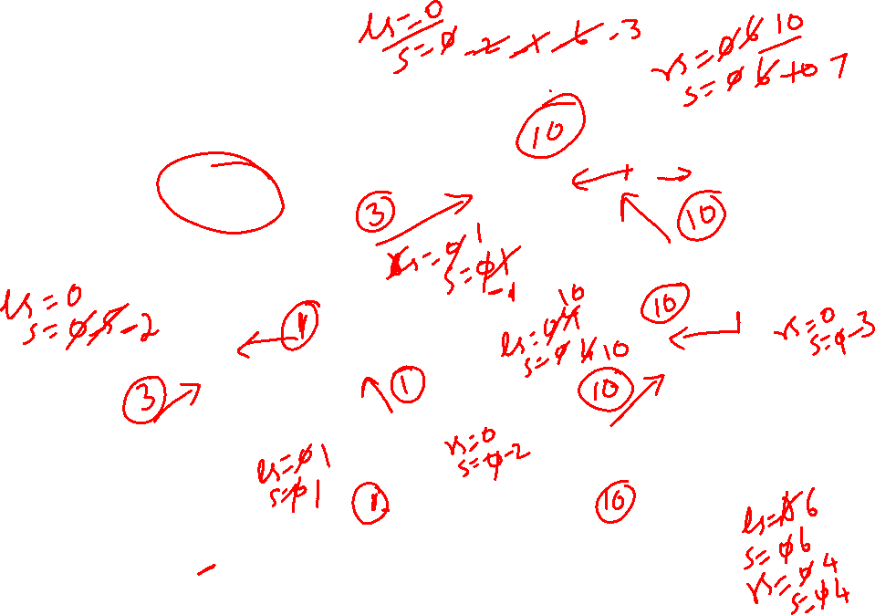
Maximum Sum Subarray - Example
3, -5, 1, -2, 6, 4, -3 Soln: 10

Slide 23
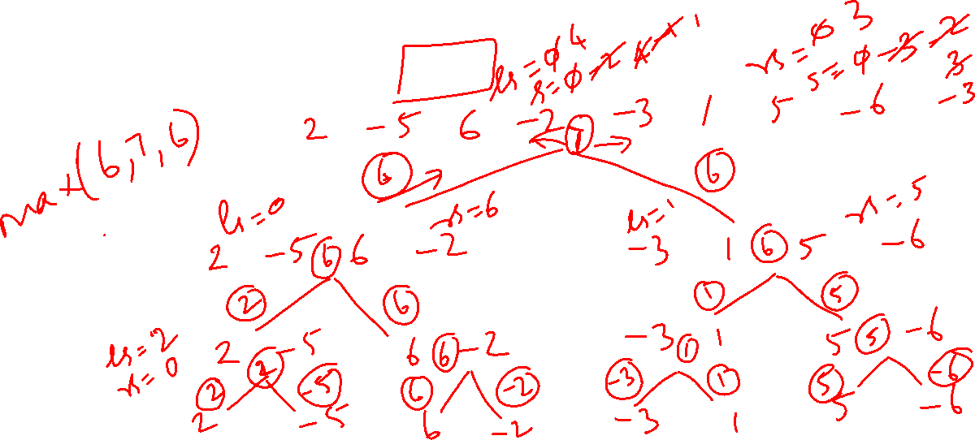
Maximum Sum Subarray - Example
2, -5, 6, -2, -3, 1, 5, -6 Soln: 7

Slide 24
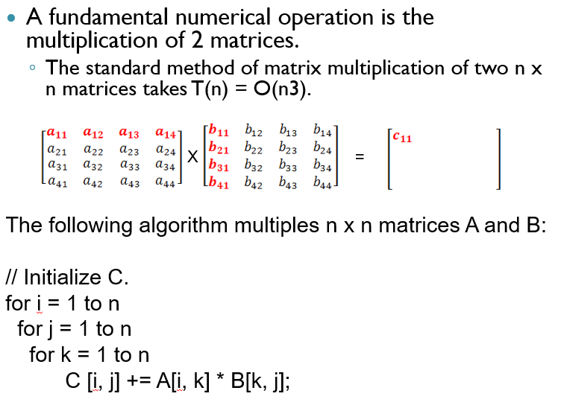
Strassen’s Algorithm

Slide 25
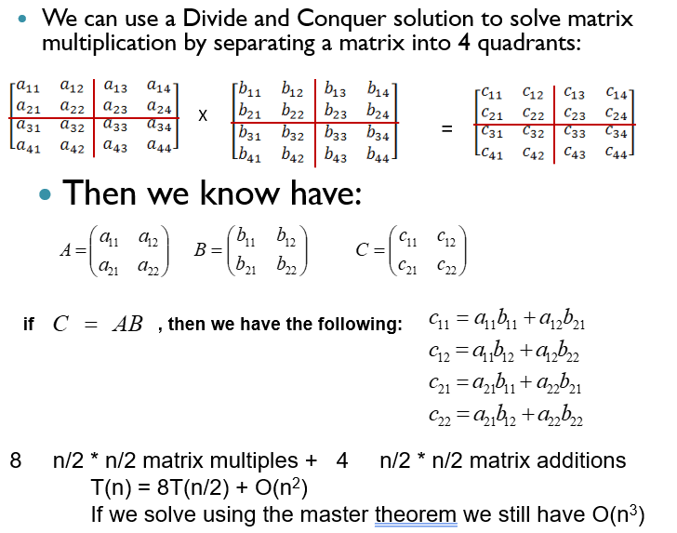
Strassen’s Algorithm

Slide 26
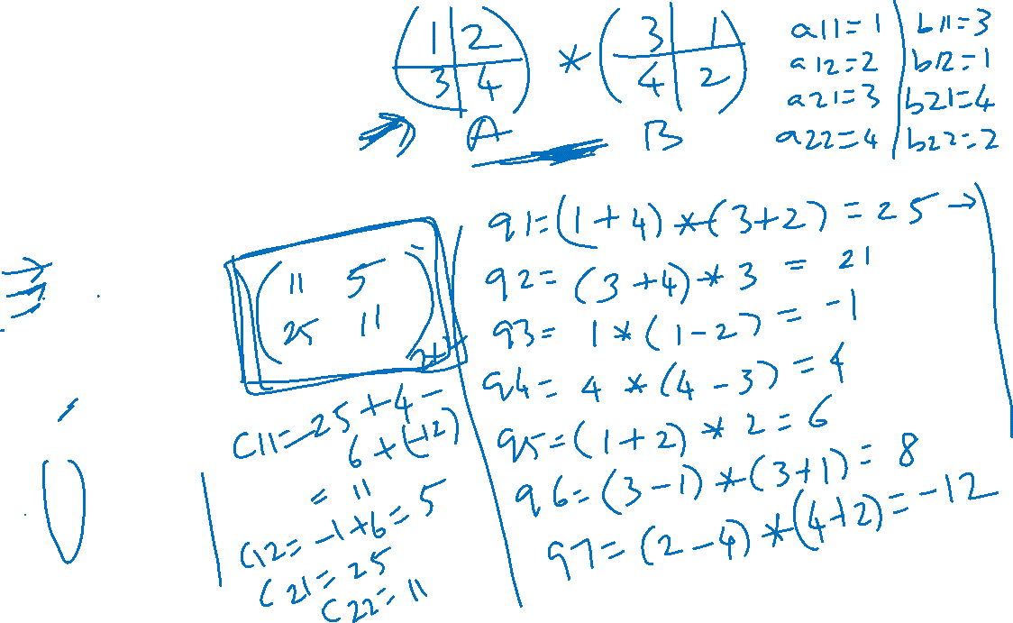
Strassen’s Algorithm
Strassen showed how two matrices can be multiplied using only 7 multiplications and 18 additions:
Consider calculating the following 7 products:
q₁ = (a₁₁ + a₂₂) * (b₁₁ + b₂₂)
q₂ = (a₂₁ + a₂₂) * b₁₁
q₃ = a₁₁*( b₁₂ – b₂₂)
q₄ = a₂₂ * (b₂₁ – b₁₁)
q₅ = (a₁₁ + a₁₂) * b₂₂
q₆ = (a₂₁ – a₁₁) * (b₁₁ + b₁₂)
q₇ = (a₁₂ – a₂₂) * (b₂₁ + b₂₂)
It turns out that
c₁₁ = q₁ + q₄ – q₅ + q₇
c₁₂ = q₃ + q₅
c₂₁ = q₂ + q₄
c₂₂ = q₁ + q₃ – q₂ + q₆

Slide 27
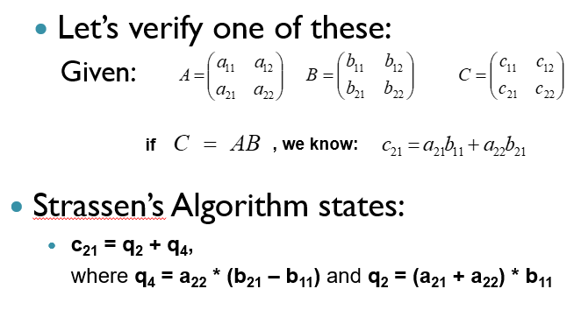
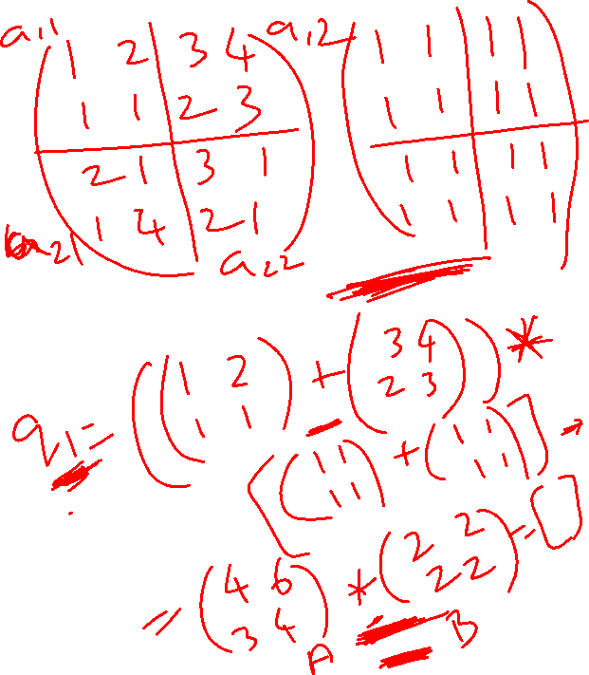
Strassen’s Algorithm

Slide 28
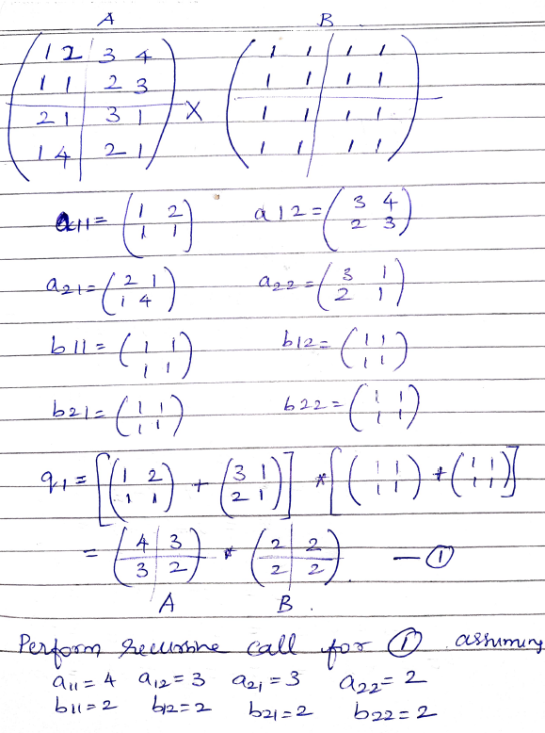
Example

Slide 29
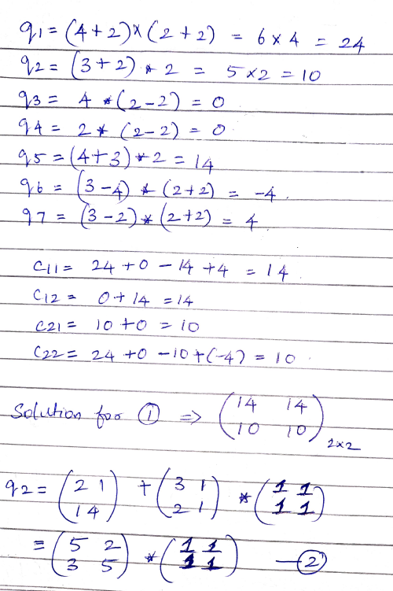
Example

Slide 30
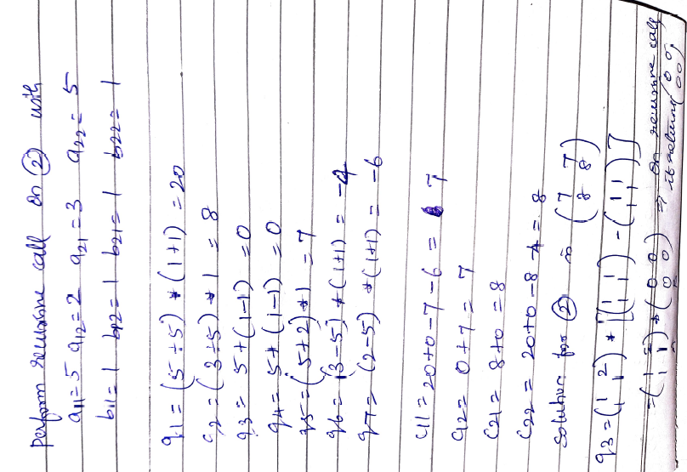
Example

Slide 31
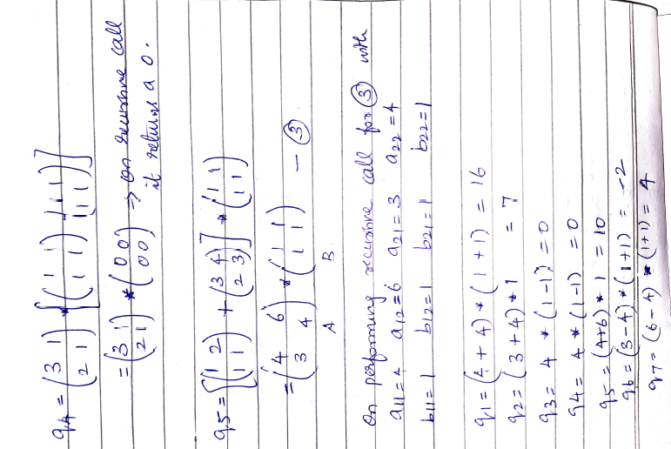
Example

Slide 32
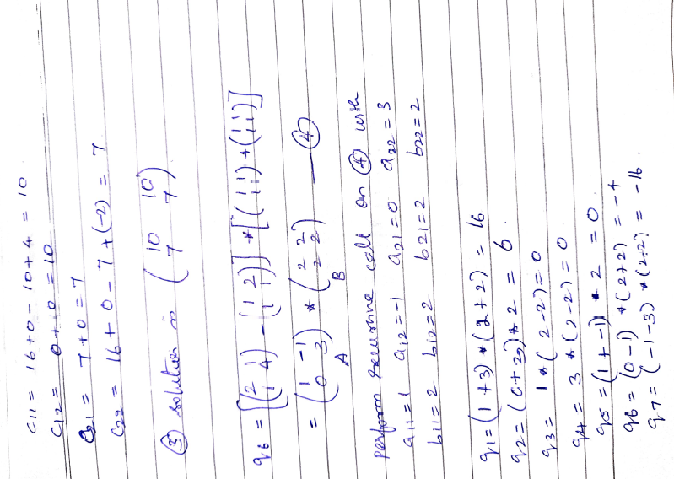
Example

Slide 33
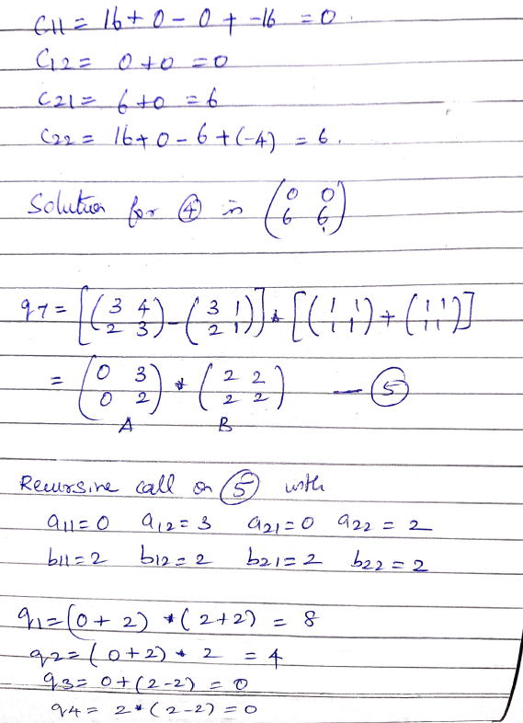
Example

Slide 34
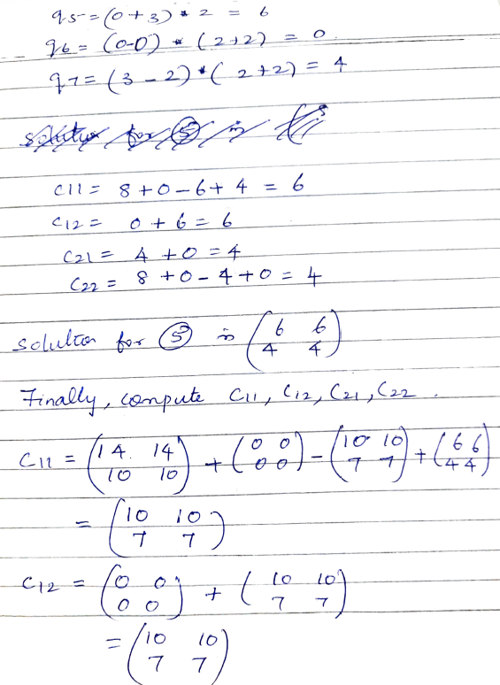
Example

Slide 35
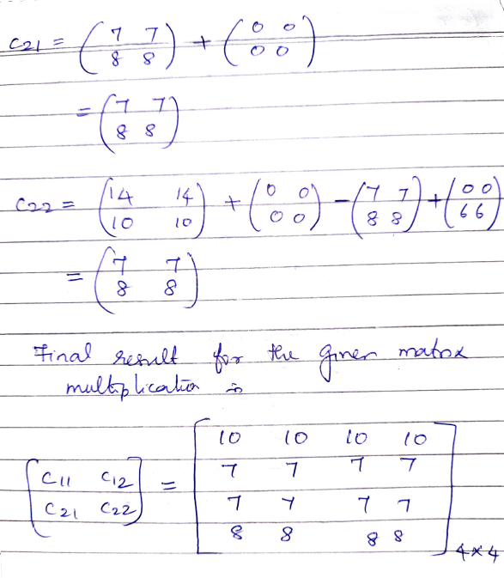
Example

Slide 36
Strassen’s Algorithm
 | Mult | Add | Recurrence Relation | Runtime
Regular | 8 | 4 | T(n) = 8T(n/2) + O(n²) | O(n³)
Strassen | 7 | 18 | T(n) = 7T(n/2) + O(n²) | O(n ^{log27}) = O(n^{2.81})

Slide 37
Strassen’s Algorithm
No idea how Strassen came up with these combinations.
He probably realized that he wanted to determine each element in the product using less than 8 multiplications.
From there, he probably just played around with it.
If we let T(n) be the running time of Strassen's algorithm, then it satisfies the following recurrence relation:
T(n) = 7T(n/2) + O(n²)
It's important to note that the hidden constant in the O(n²) term is larger than the corresponding constant for the standard divide and conquer algorithm for this problem.
However, for large matrices this algorithm yields an improvement over the standard one with respect to time.

Slide 38
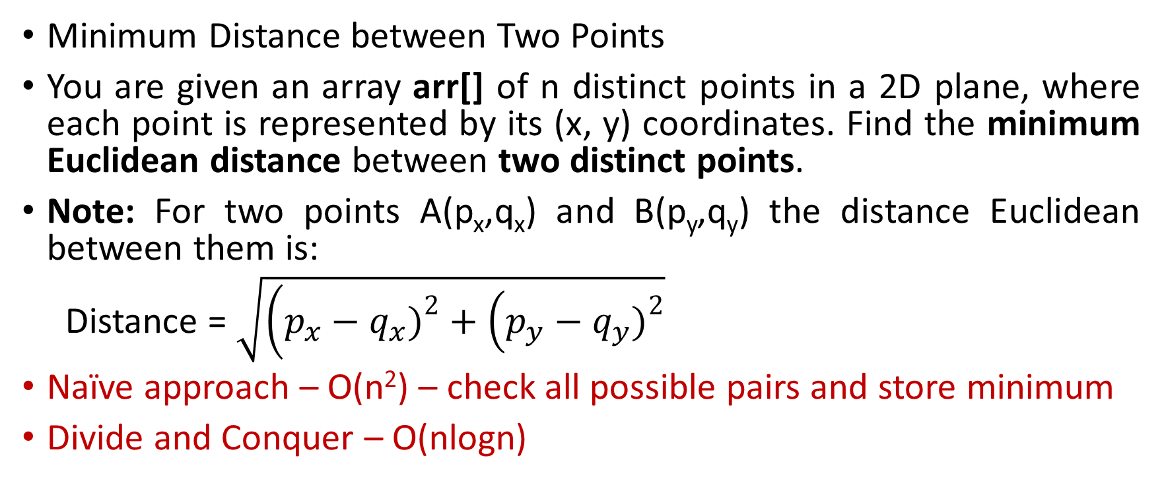
Closest Pair Algorithm
Minimum Distance between Two Points
You are given an array arr[] of n distinct points in a 2D plane, where each point is represented by its (x, y) coordinates. Find the minimum Euclidean distance between two distinct points.
Note: For two points A(p_{x},q_{x}) and B(p_{y},q_{y}) the distance Euclidean between them is:
Distance = $\sqrt{\left(p_{x}−q_{x}{\left.)\right.}^{2}+\left(p_{y}−q_{y}{\left.)\right.}^{2}\right.\right.}$
Naïve approach – O(n²) – check all possible pairs and store minimum
Divide and Conquer – O(nlogn)

Slide 39
Closest Pair Algorithm
Sort the points by x-coordinate.
Recursively divide the points into left and right subarrays until each subarrays has one or two points:
If one point, return infinity.
If two points, return their distance.
Find the minimum distances dl and dr in the left and right subarrays, and set d as the smaller value between dl and dr.
Check points near the dividing line (strip of width d) – to find cross pairs
Return smallest distance found

Slide 40
Closest Pair Algorithm
CLOSEST_PAIR(P, n) if n <= 3 return minimum distance by brute force // O(1) mid = n / 2 dl = CLOSEST_PAIR(PL, mid) dr = CLOSEST_PAIR(PR, n - mid) d = minimum(dl, dr)
// O(n) to find points in strip within distance d
Build strip[] containing points from Py whose |x - mid_x| < d ds = StripClosest(strip, d)
return minimum(d, ds)
StripClosest(strip, d)
Let min = d
For i = 1 to strip.length:
For j = i+1 to strip.length
while (strip[j].y - strip[i].y < min):
compute distance
update min if smaller
Return min

